Slide 1
Lecture 14
Norton Theorem
Maximum Power Transfer Theorem

Slide 2

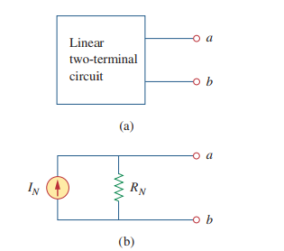
Norton Theorem

Slide 3
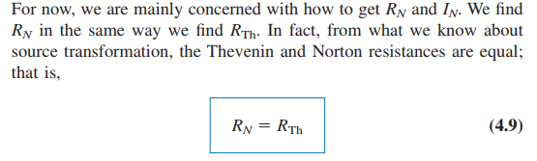

i) Finding $R_{N}$

Slide 4
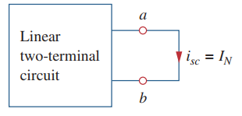


ii) Finding $I_{N}$

Slide 5


Slide 6
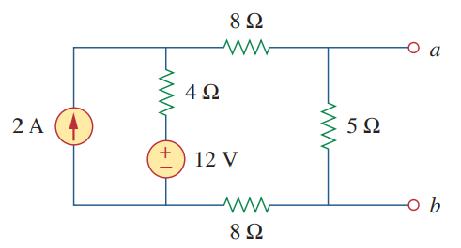
Example 4.11

Slide 7
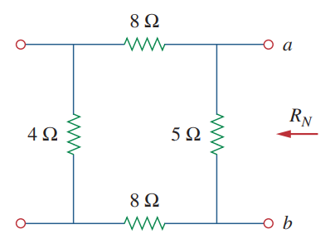


Finding $R_{N}$

Slide 8
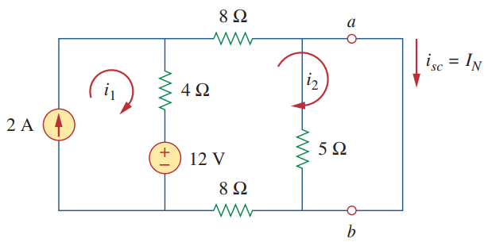


Finding $I_{N}$

Slide 9
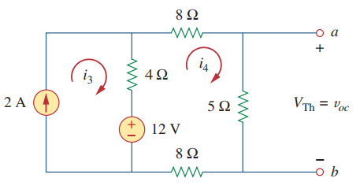
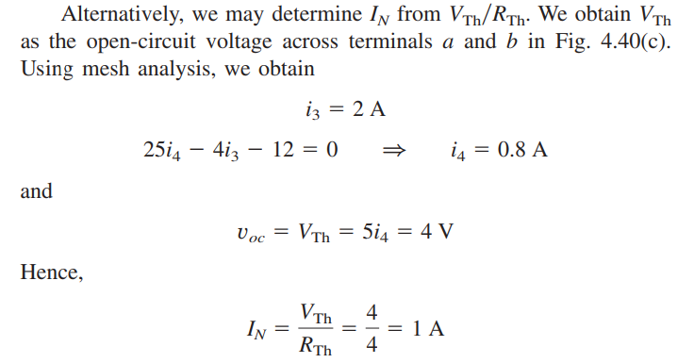

Finding $V_{Th}$

Slide 10
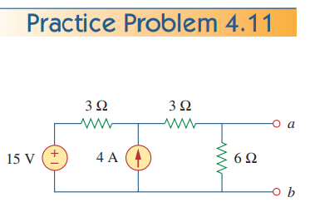


Slide 11
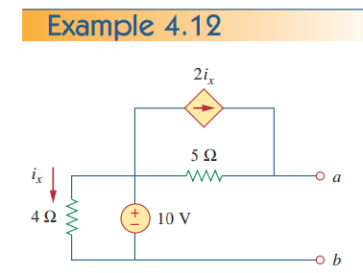


Slide 12
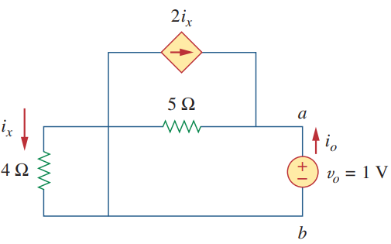

$$R_{N}$$

Slide 13
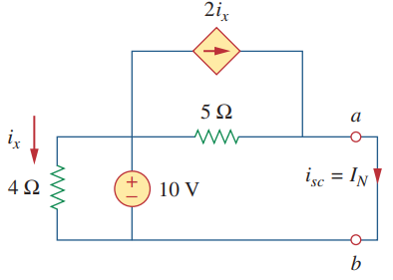

Slide 14
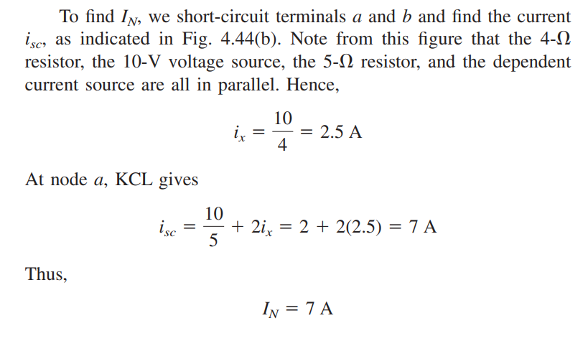

Slide 15


Slide 16


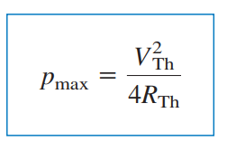
Maximum Power Transfer
This is known as maximum power theorem.
The max. power is obtained as

Slide 17
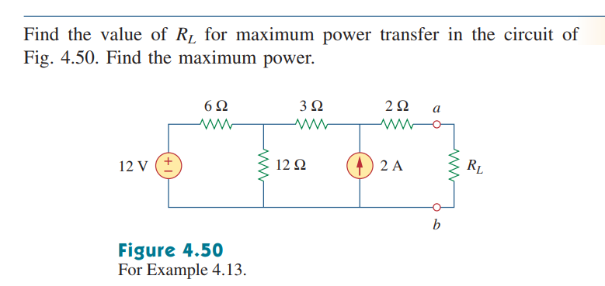
Example 4.13

Slide 18
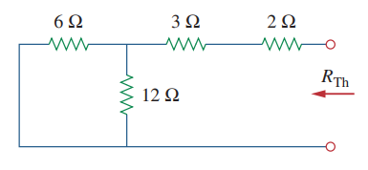


Slide 19
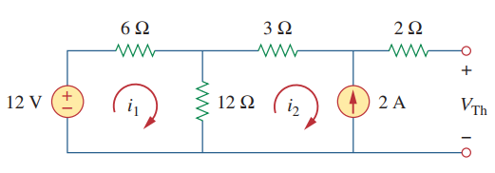
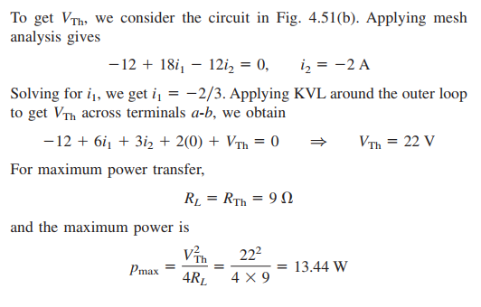

Slide 20
Thank You

